Slide 1

Beginner Svelte Training

Slide 2
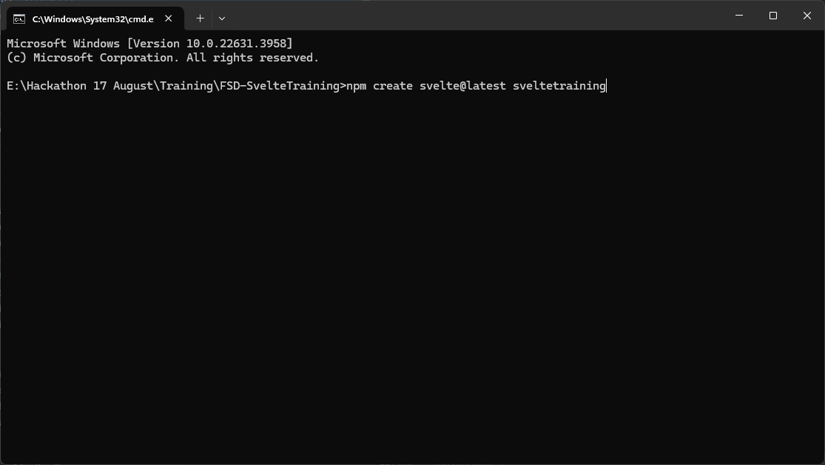
0a – Installing Svelte

Slide 3
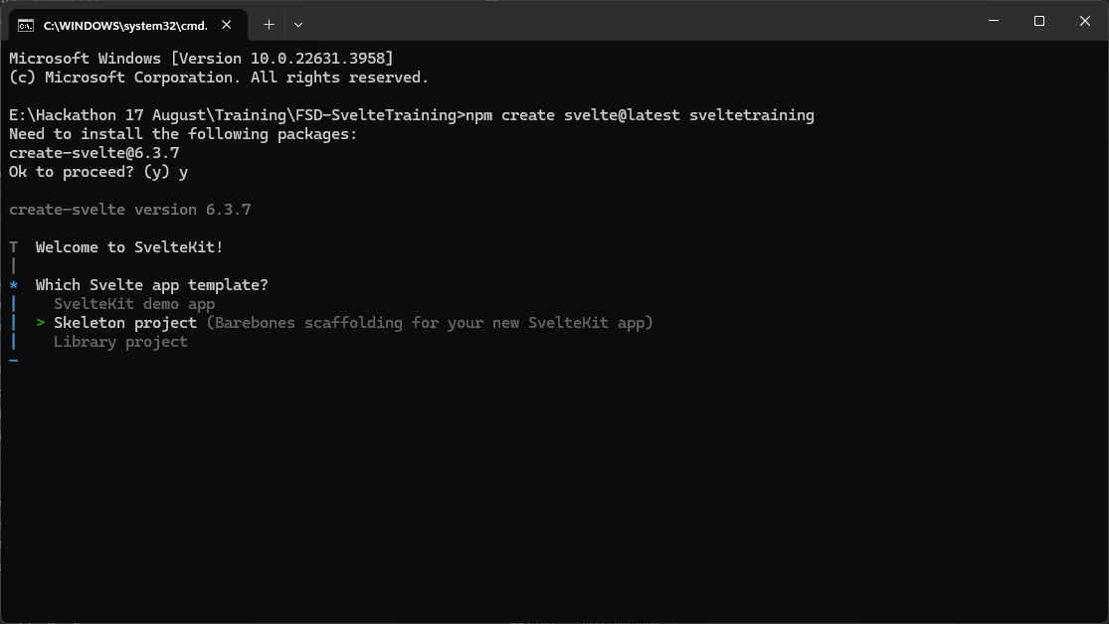
0b – Selecting Skeleton Project

Slide 4
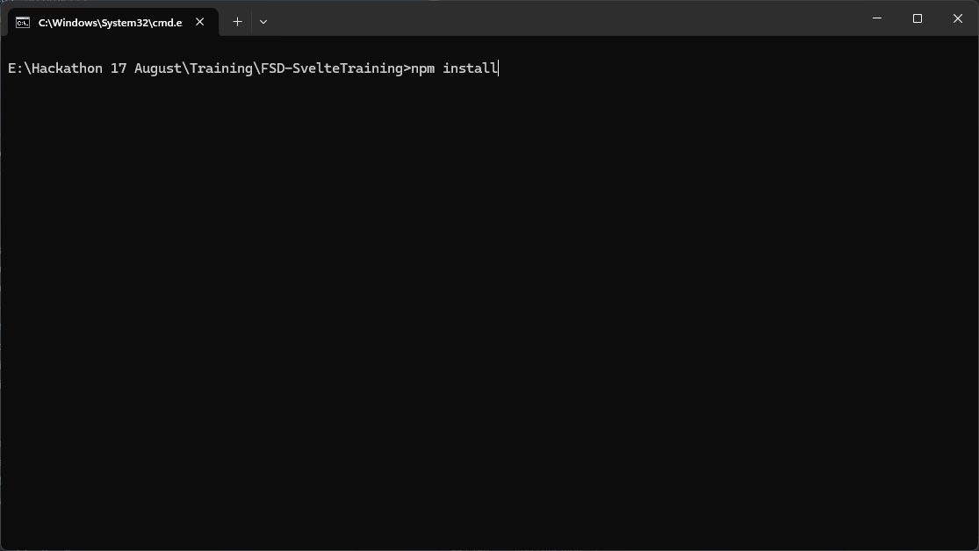
0c – Run npm Install

Slide 5
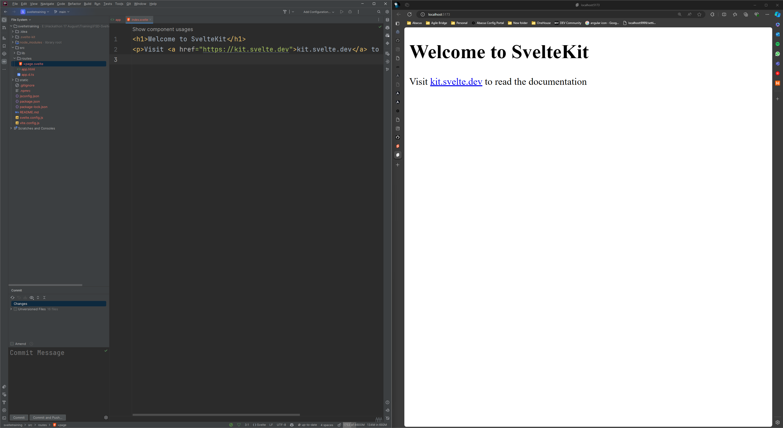
0d – The site up and running

Slide 6
Templating

Slide 7
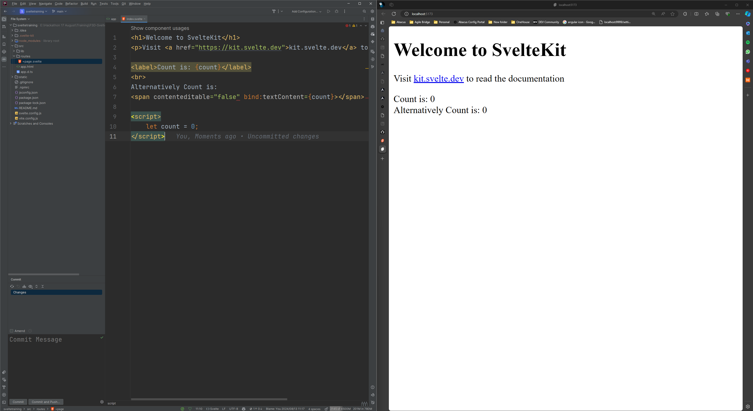
1a. One Way Bound Data

Slide 8
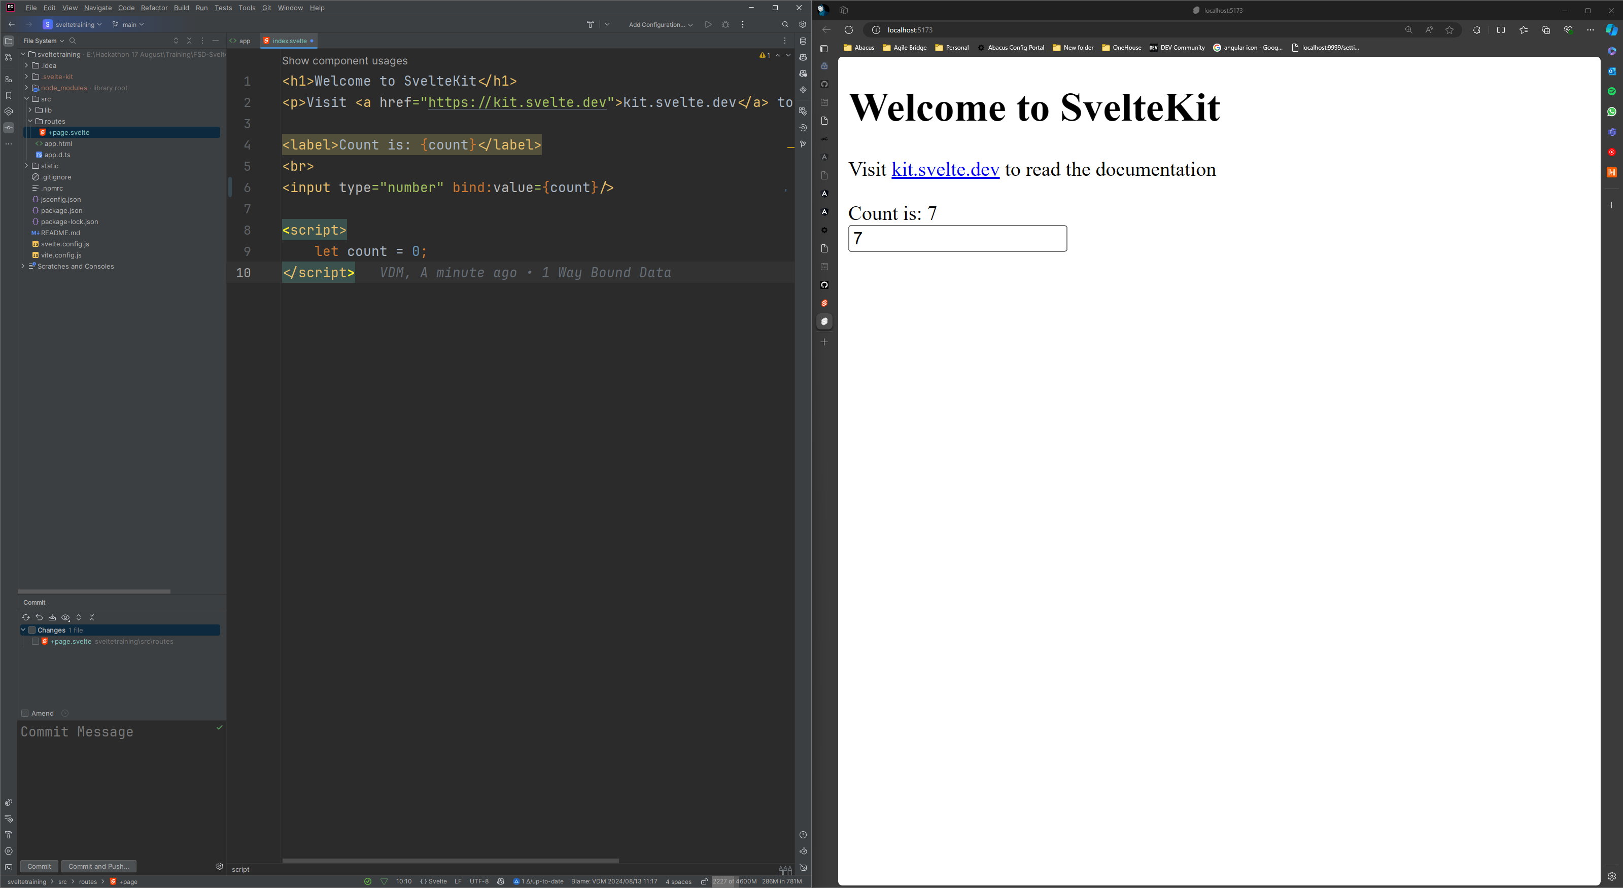
1b. Two Way Bound Data

Slide 9
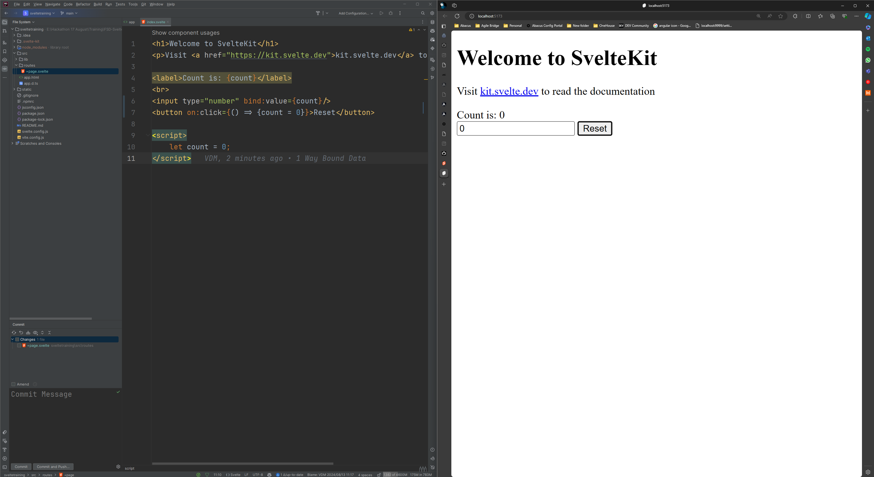
1c. Event handling

Slide 10
Componentization

Slide 11
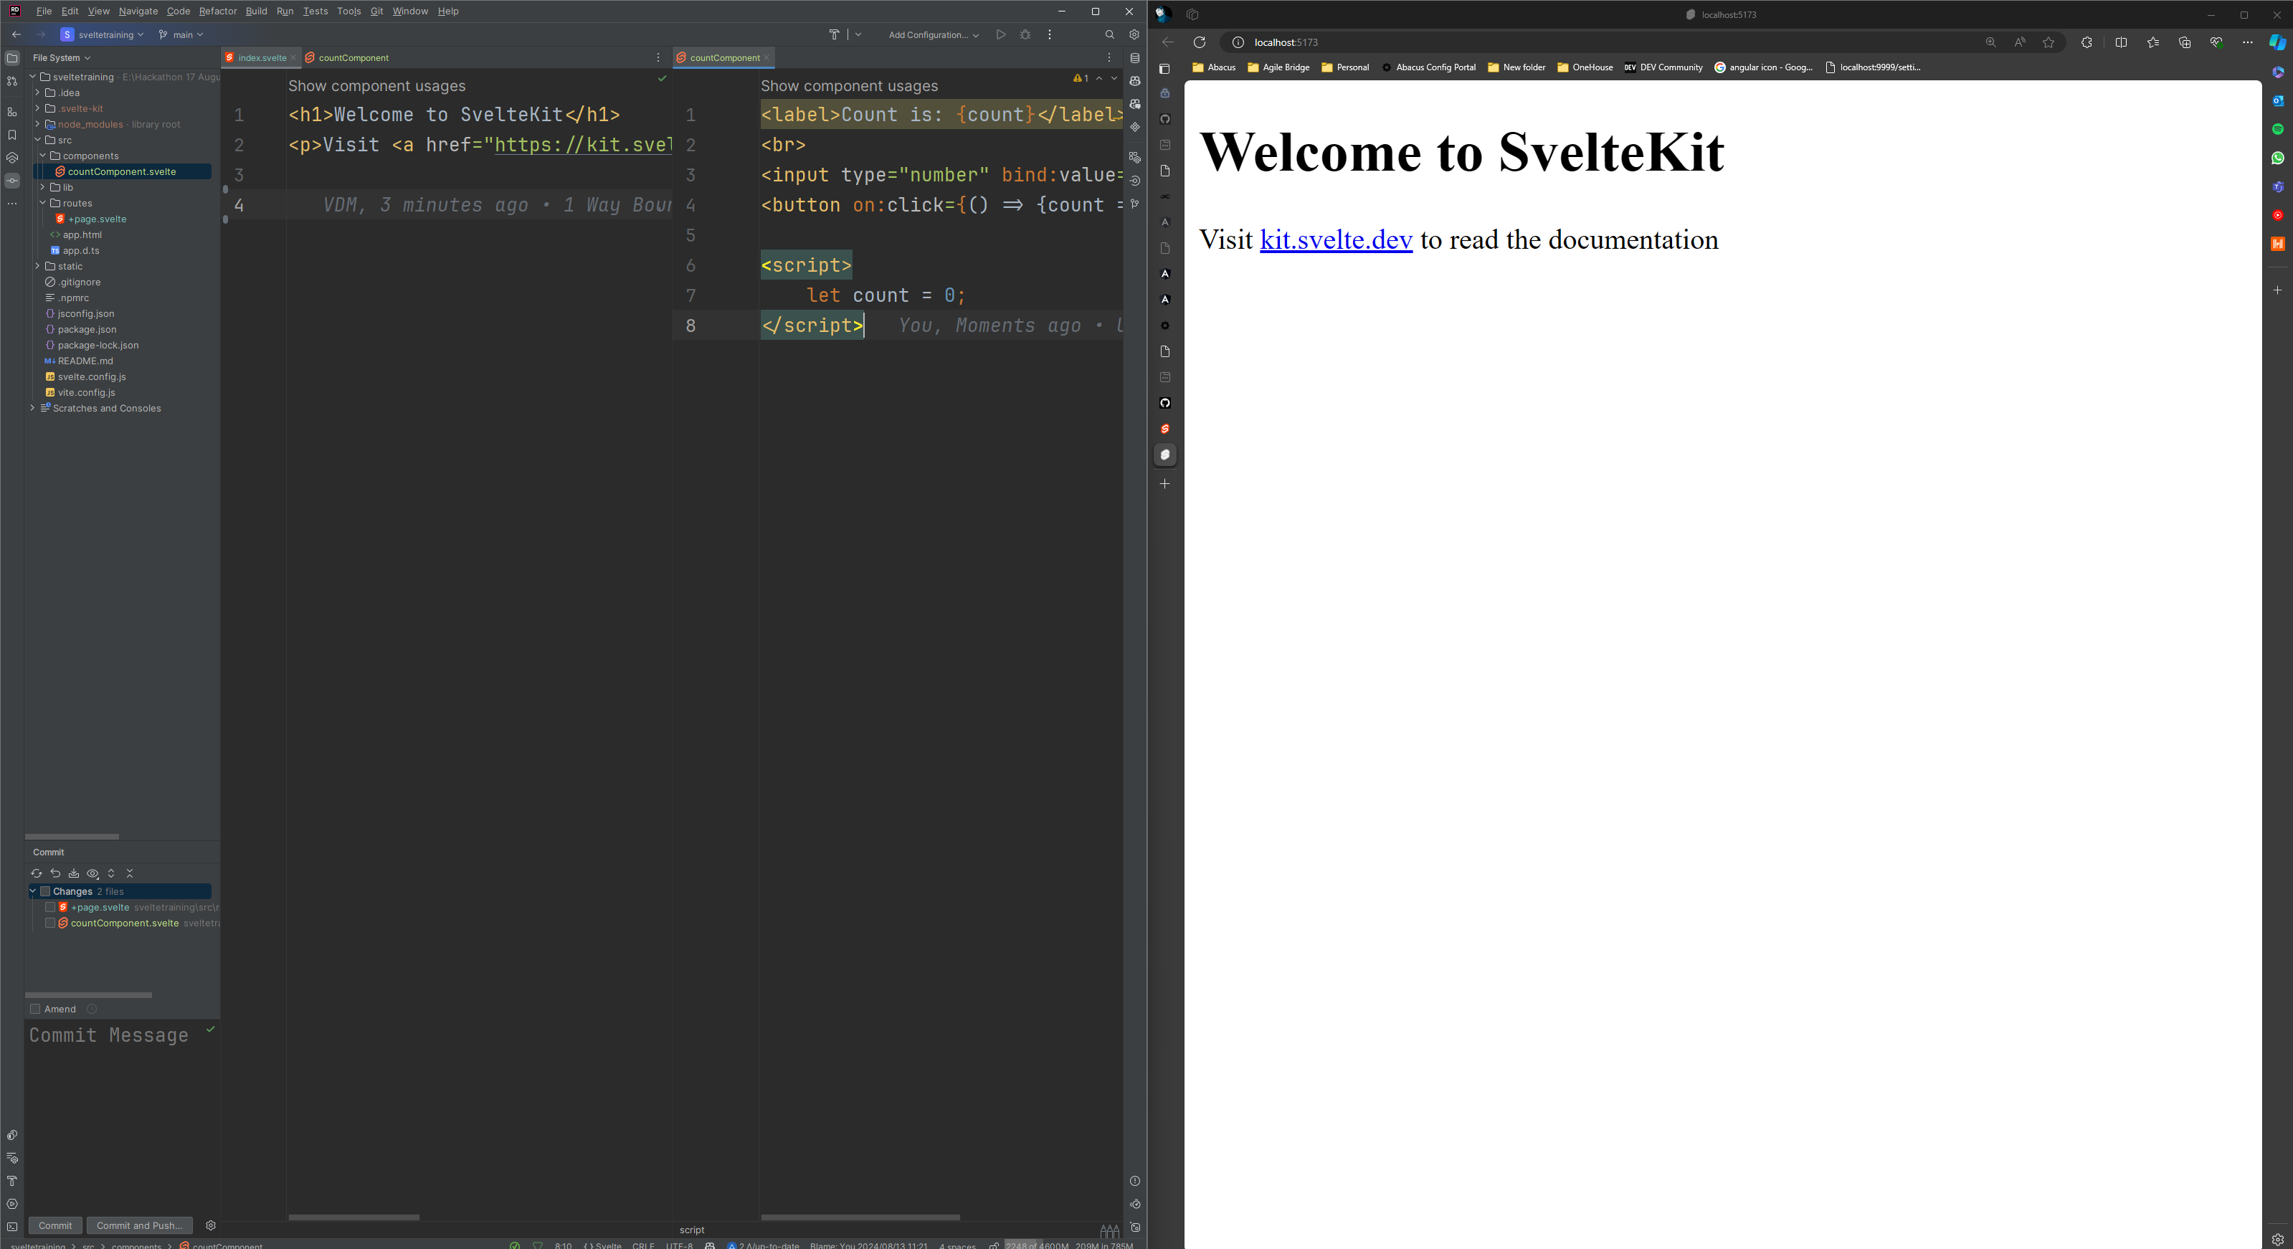
2a. Creating a component

Slide 12
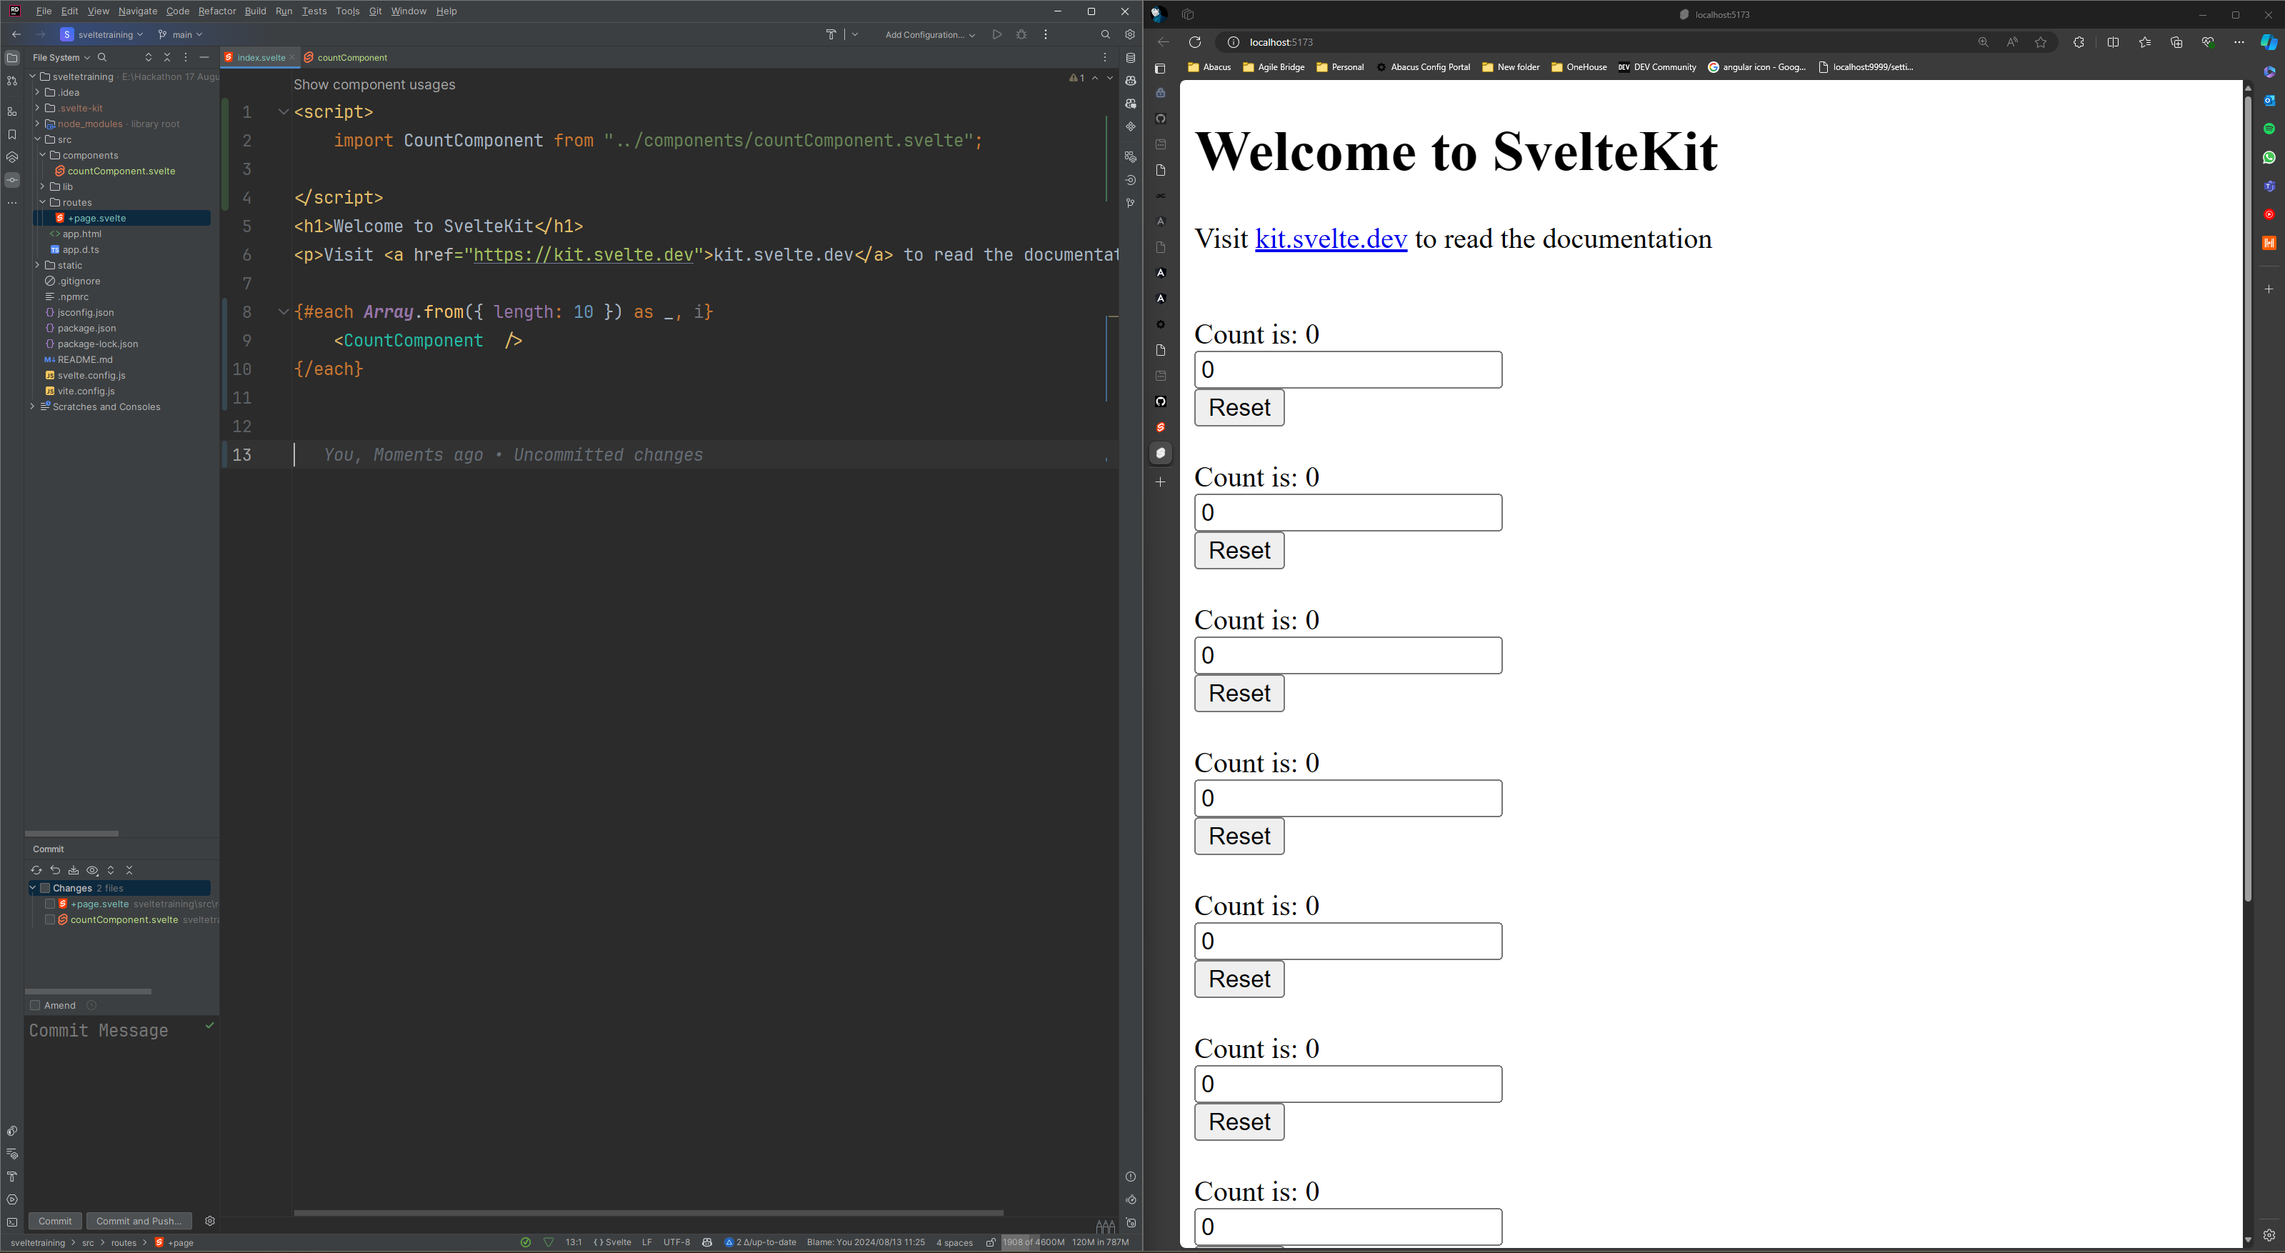
2b. Using the component

Slide 13
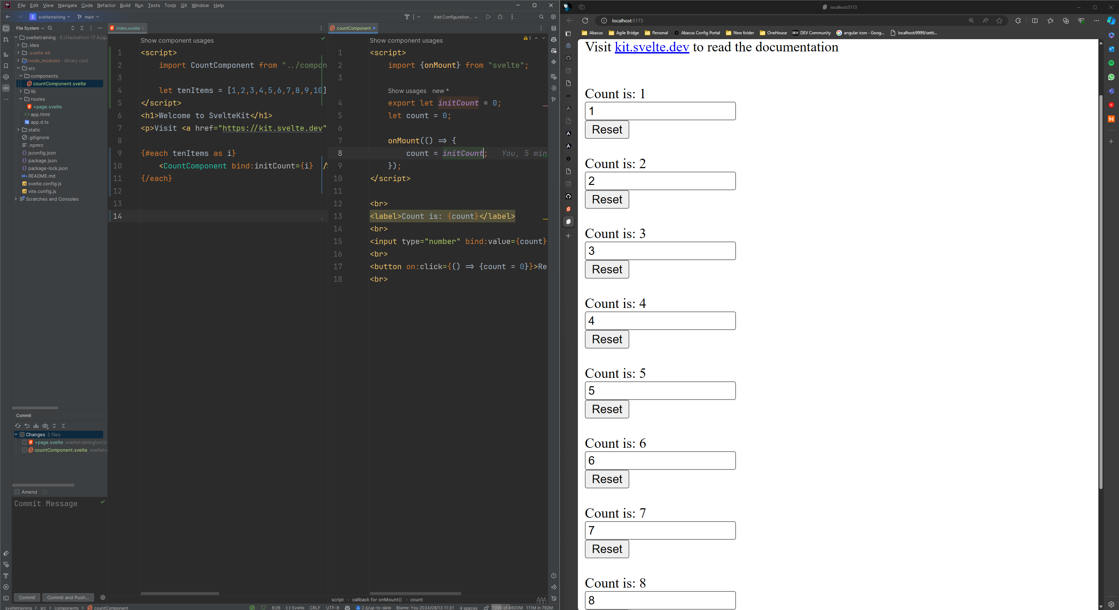
2c. Passing Data (props) to components

Slide 14
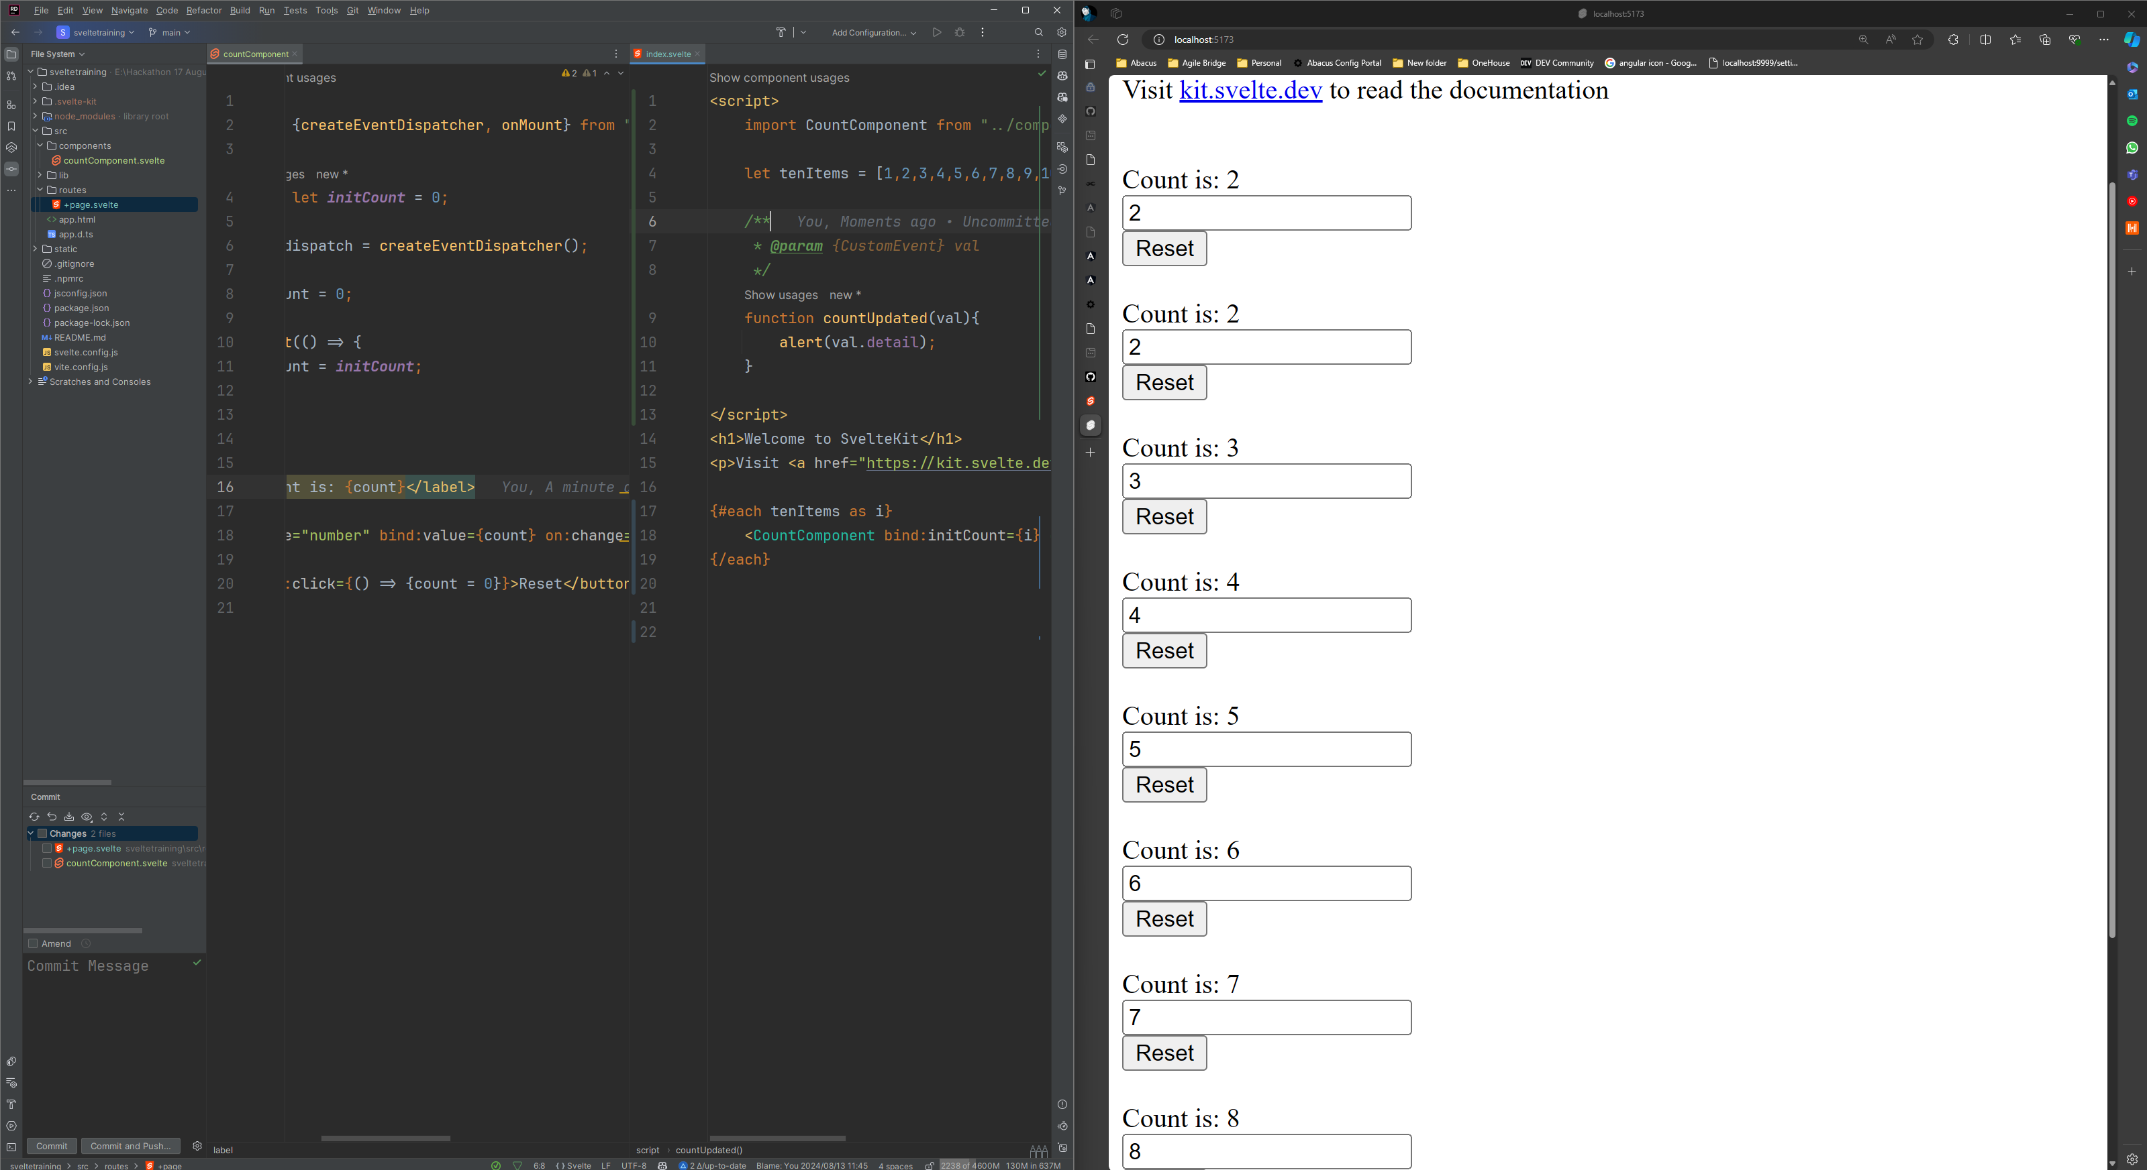
2d. Emitting Changes

Slide 15
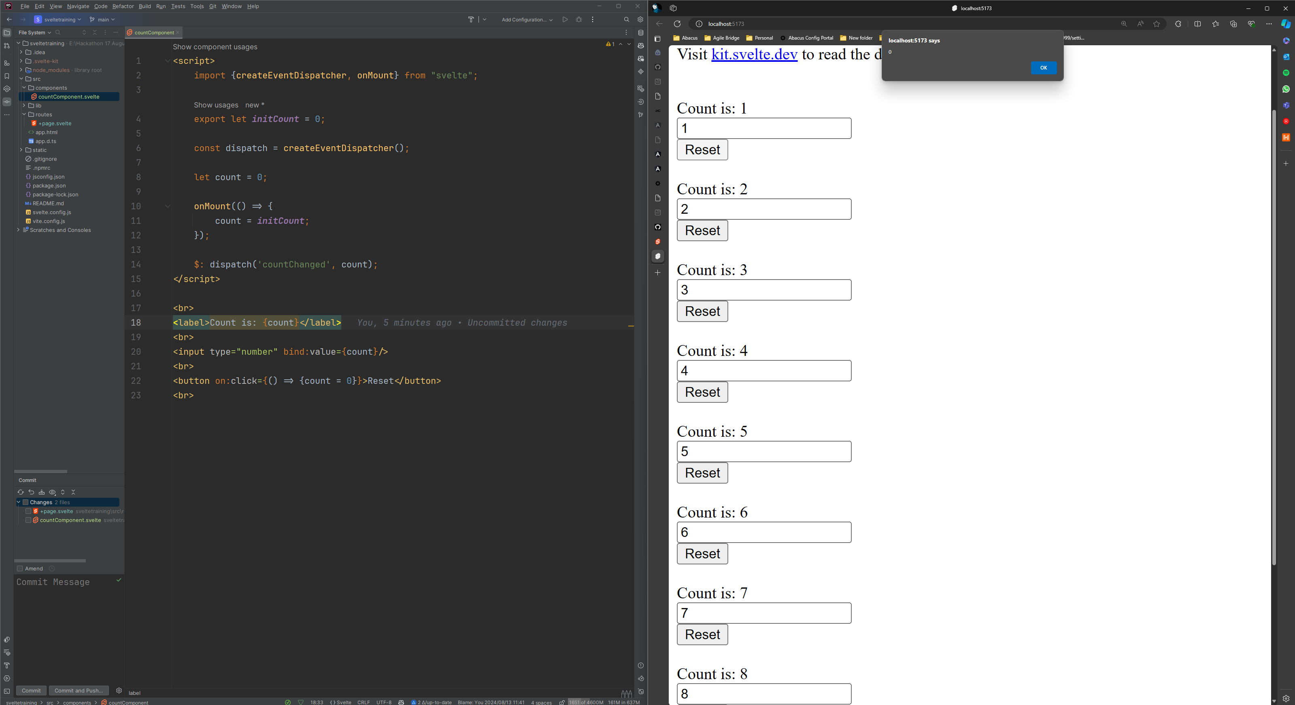
2e. Watching Changes

Slide 16
Life Cycles

Slide 17
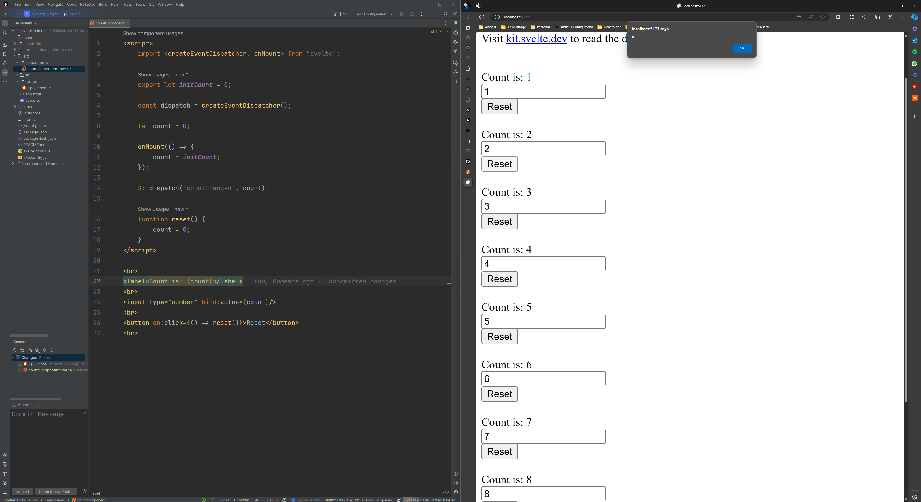
3a. Manually triggered Functions

Slide 18
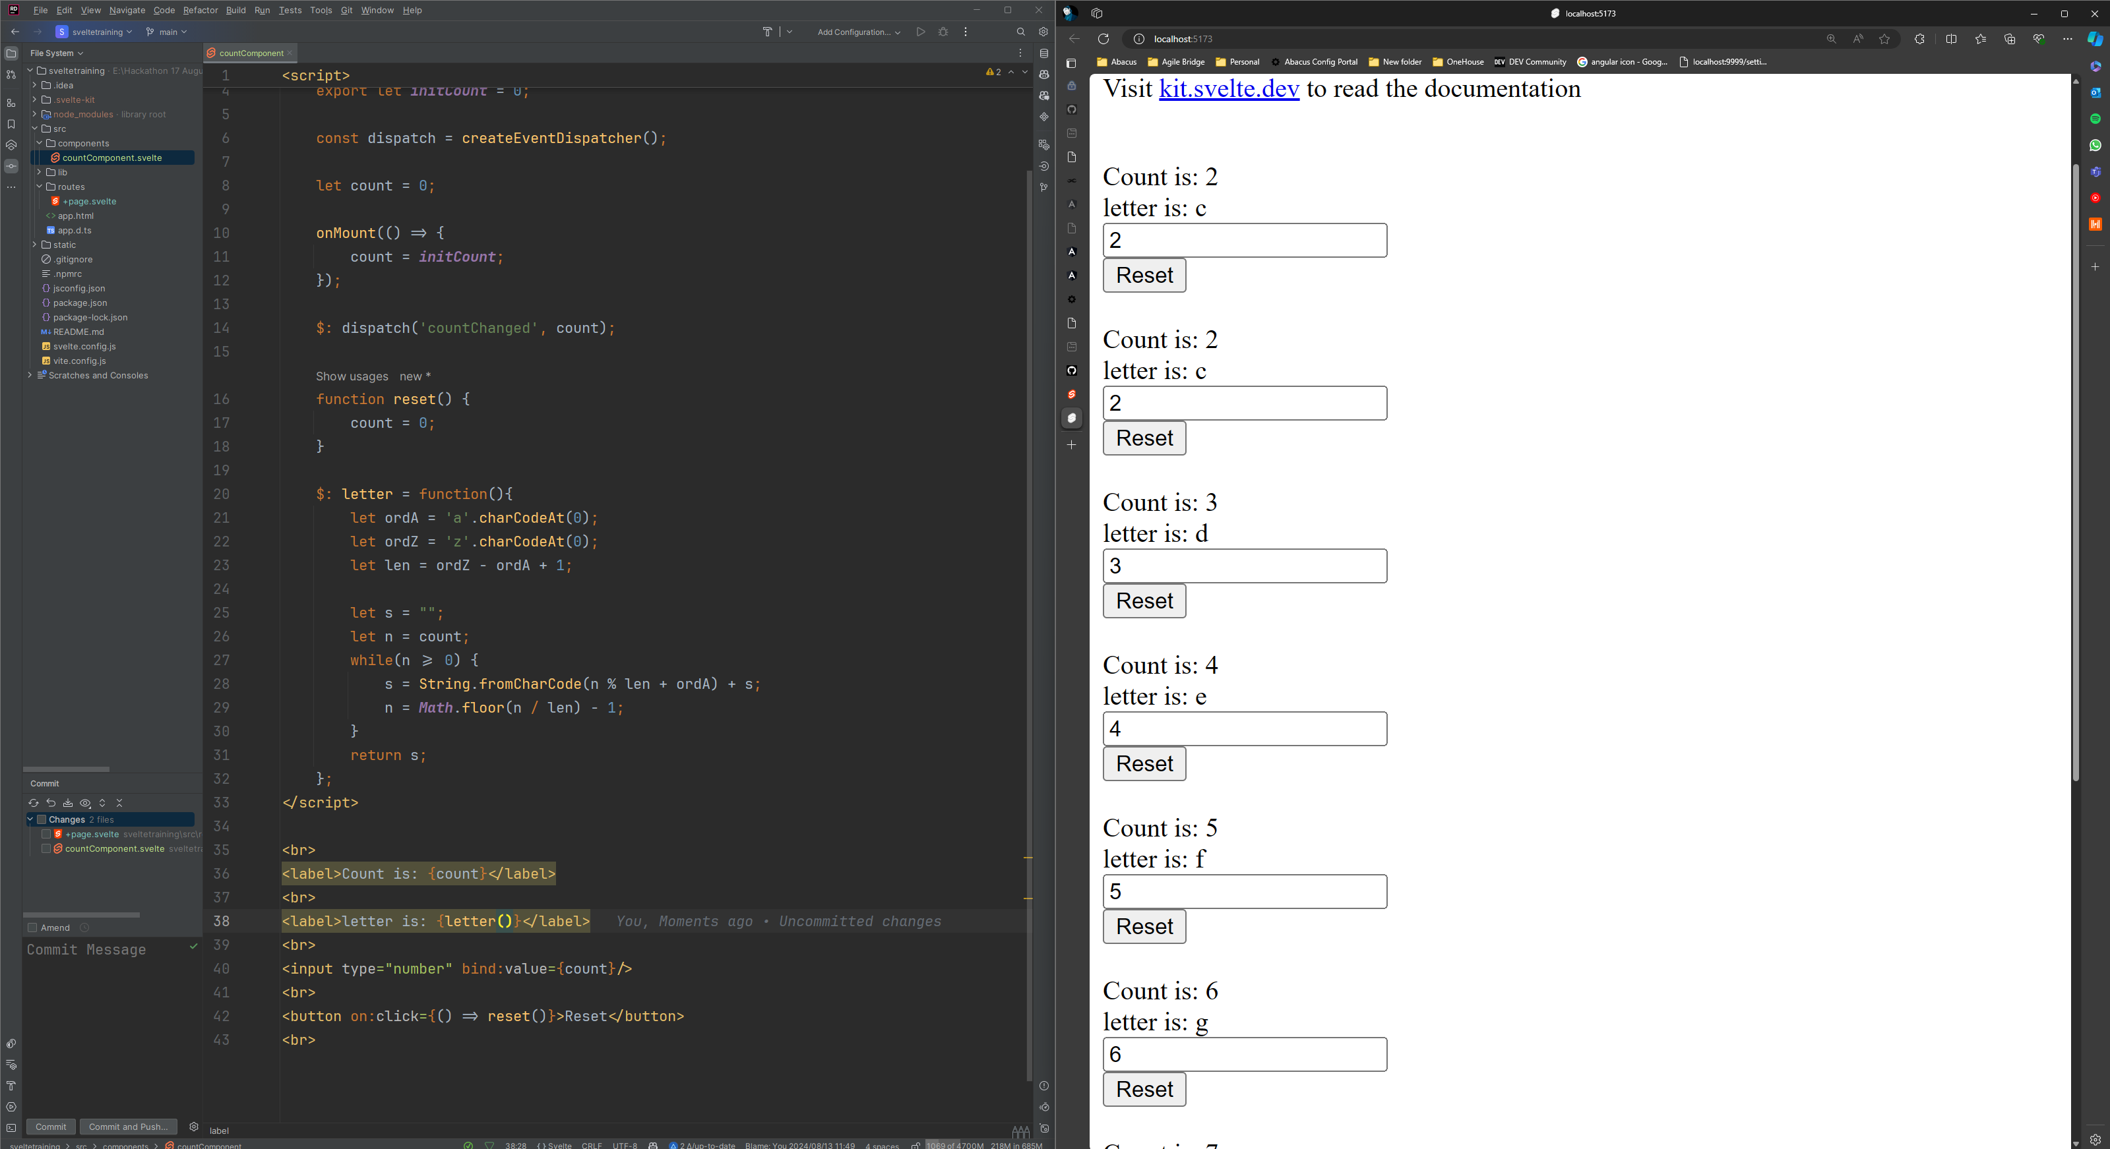
3b. Computed Functions

Slide 19
Routing

Slide 20
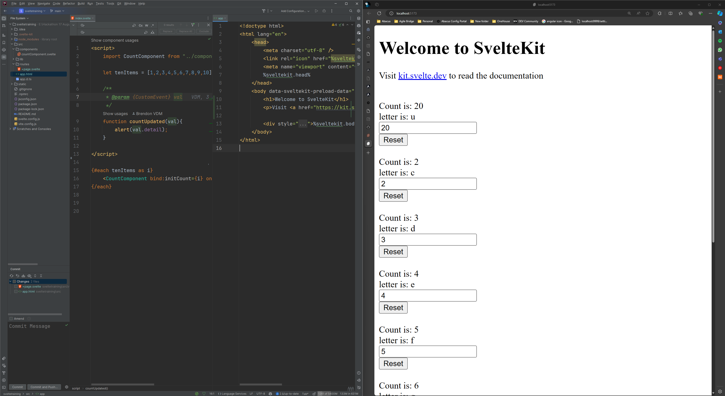
4a. Setting up App and Index Page

Slide 21
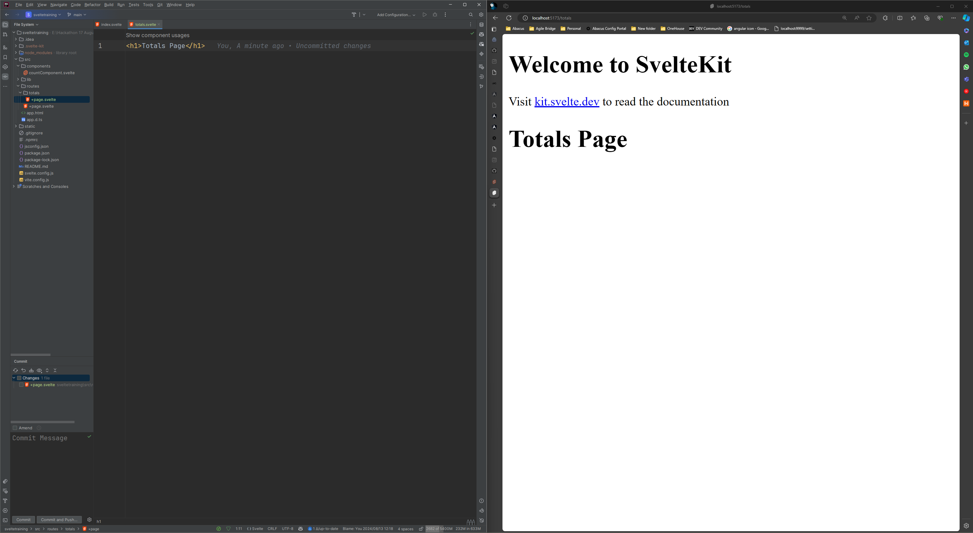
4b. Creating a new Page

Slide 22
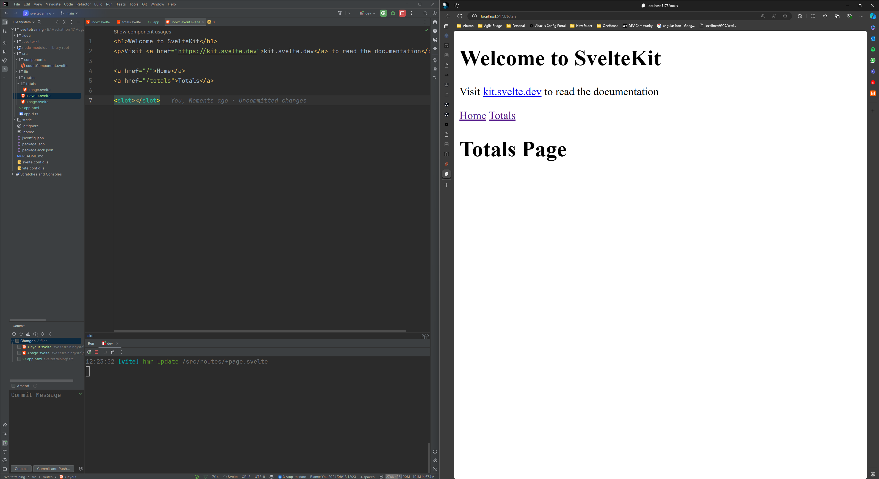
4c. Navigation Through Links

Slide 23
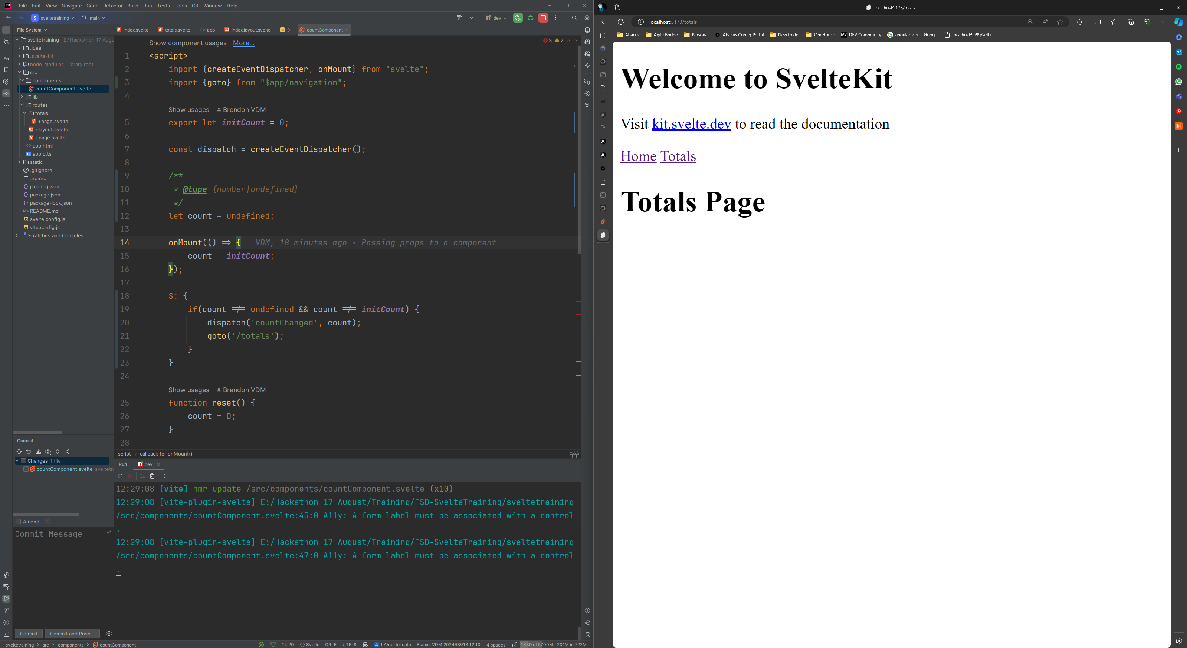
4f. Navigation Through Code

Slide 24
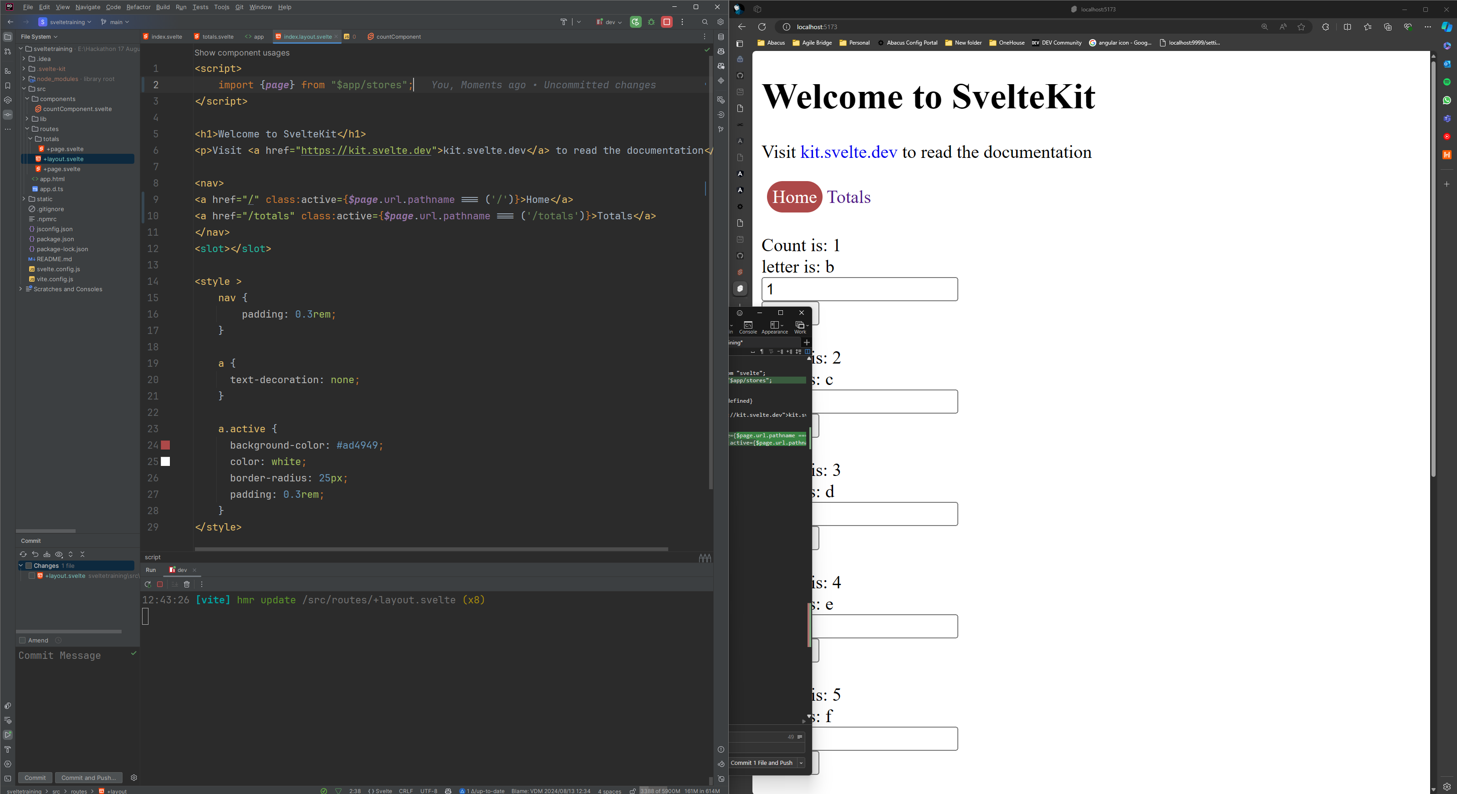
4g. Highlighting Active Page

Slide 25
Global Storage

Slide 26
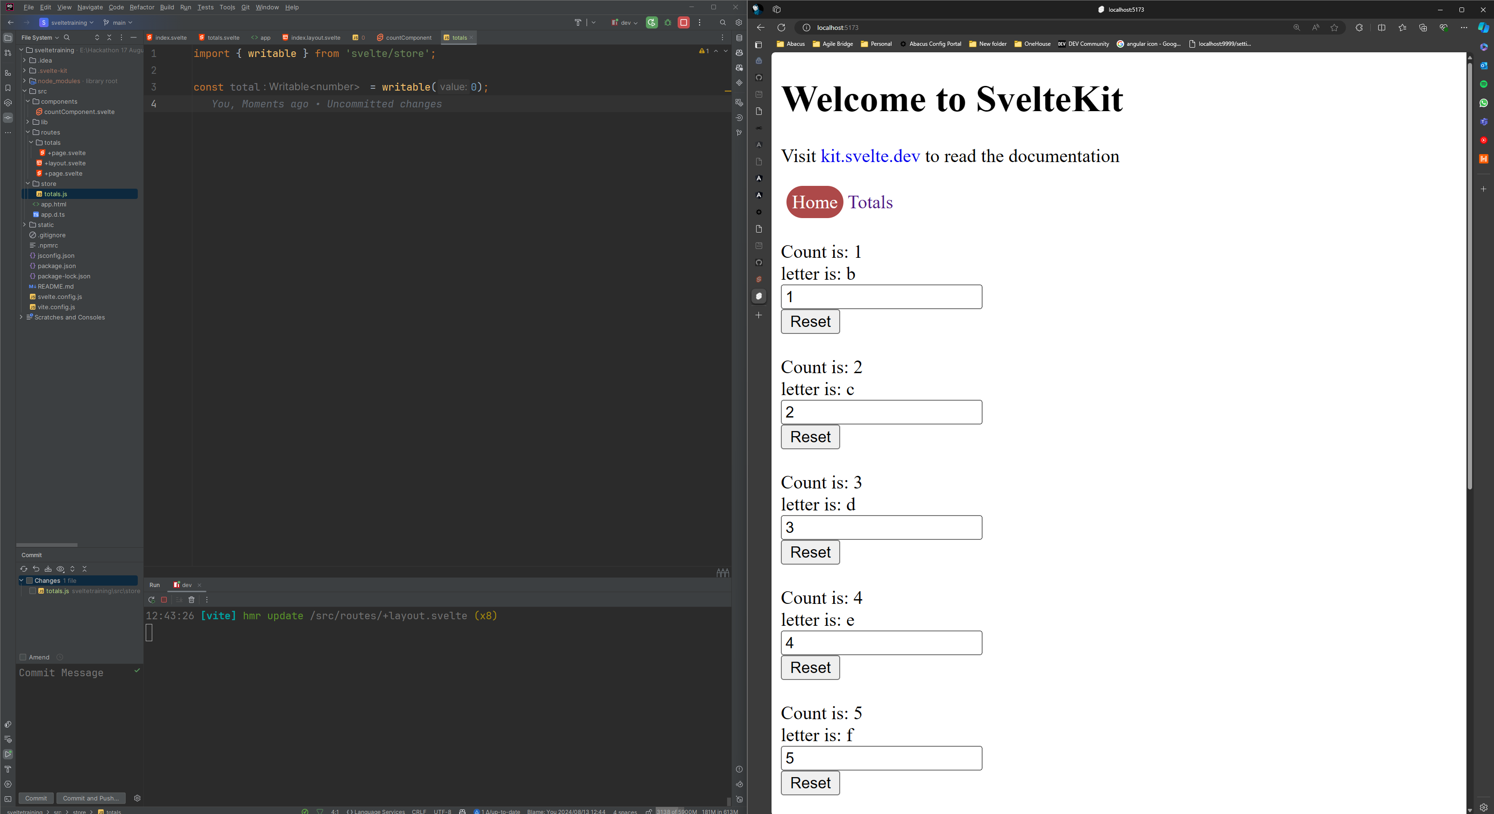
5c. Defining a store

Slide 27
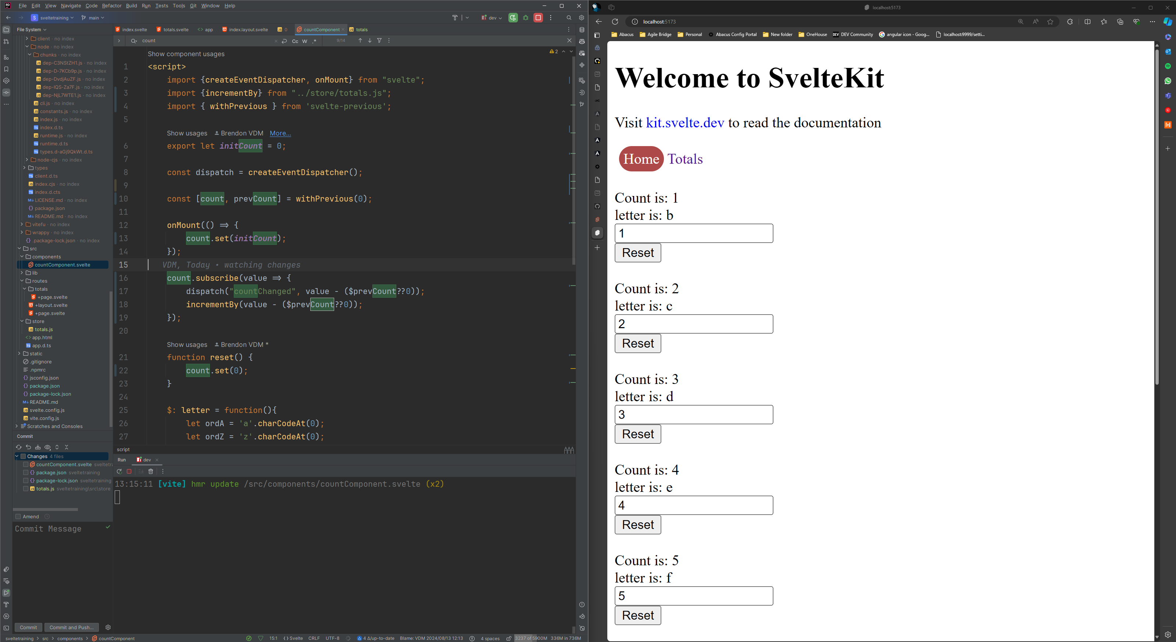
5d. Updating The Store Values

Slide 28
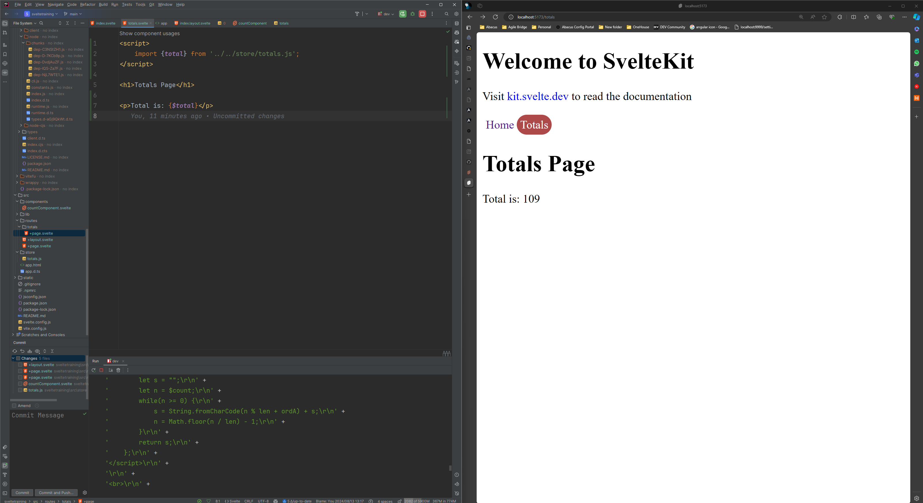
5e. Displaying store values

